Slide 1
“Forewarned is forearmed”
None of us know how this virus disruption will progress but thinking about strategies for what might come next can help us have a sense of coping with and thriving within this environment.

Slide 2
How has COVID-19 affected our work for the better?
Greater interest in story telling and capturing older generation stories. They have something to tell us about coping now. (Polio, wartime, Spanish flu etc…)
Older generations becoming more tech savvy or accepting that online chats and video conferencing software can help them.
Accepting that face to face is not possible and a telephone is acceptable.
Greater media interest. Radio Adelaide, The Age and ABC Morning show.

Slide 3
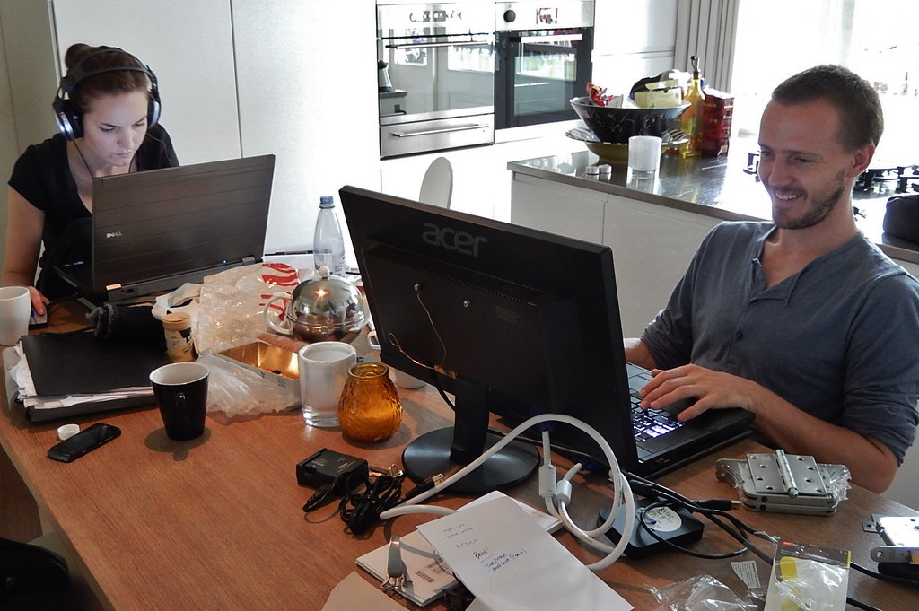
How has COVID-19 adversely affected our market and business?
Clients reluctant to start life story telling because they want a face-to-face interview, but are afraid of infection.
Mastering different technology to match the changing environment.
Crowded home spaces when family are home when we are working.
Supporting family with remote learning/working.

Slide 4
Tell tale signs of not coping for you and for clients.
Trouble sleeping.
Anxiety.
Depression.
Angry outbursts.
Flashbacks to other trauma.
Alcohol or substance abuse.
Staring off into the distance.
Not present or easily distracted.
Cutting off family.
Risky behaviour,
Hyper vigilance or on edge.
Emotional roller coaster.
Not wanting to do your usual things.
Feeling generally “out of sorts”.

Slide 5
What to do – be prepared – forewarned and forearmed?
For client
For yourself
Put them at ease - explain the interview process. Note taking, recording, what happens, rules of engagement.
Let them ask questions.
Set boundaries – what won’t be discussed.
Victims might feel shame, acknowledge the feeling and help them through.
If you know you have a traumatic interview coming up prepare them. Ask what they will want to do afterwards or who they might call . Forewarned and forearmed.
Create your own self care worksheet with instructions on what to do when you feel out of sorts after a traumatic interview or in these times. ( Will distribute).
Acknowledge to yourself that it is OK to feel these feelings and they will pass.

Slide 6
What challenges have you faced?
What have you done about them?
Have you prepared yourself in any way for what might come next?
No one is an expert and we are all learning how to deal with the new and ever-changing normal.

