Slide 1
Biographers’ International conference 2023
Sharing what I learned in New York, Deborah Gough

Slide 2
Organising your information
Scrivener
Designed for authors, researchers and writers
Multipage engagement (side by side)
Great for outlines
Easy to push out as an ebook or news article
Auto save to Dropbox
OCR doesn’t make them searchable, but there are ways around it.
Not shareable.
Evernote
You make notebooks and create tags which are searchable.
Clip articles from online
If text is high quality you can search text in notes.
Photographs can be tagged. This makes them searchable.
You can annotate PDFs.
Can clip an email into Evernote. (Useful when clients use email to respond to questions).
Audio files can be clipped into Evernote.
Shareable if working with someone on a project.

Slide 3
Notes and responses
Some people use Evernote and Scrivener together pulling Evernote notes into Scrivener and using Scrivener to write and outline.
Drawbacks: Scrivener not friendly to the driver and not shareable.
Costs: Evernote cost 0-$22.49 per month. Scrivener A$89.99.
Excel as good as any for creating a timeline.
Or you can try Zoltaro. It is more for academics but it will make bibliographical references in any style.
No magic bullets.

Slide 4
Trusting memoirs This was mostly for deceased subjects, which is not our work usually, but it was interesting.
Can you trust a memoir written by the person you are writing about? Basically, no unless you can corroborate facts.
Jane Addams’ Twenty Years of Hull-House (Chicago reformer helped develop settlements for migrants and the poor). First half of the book is memoir and she basically says some of it she’s making up.
Combat loose truths by building a place for a theme which forms the truth. For instance, Adams was 2 ½ when her mother died which lends itself to a theme of the subject leading a life where she protects the poor from early deaths.
Don’t use previous memoirs as gospel but work around it where the truth is not clear. Create a narrative that the reader can believe.
If something is mis-remembered, ask why it might be mis-remembered? Discuss it.

Slide 5
Publicising your book and getting a publisher
Think about your market for the book. Who is going to read it and build a business plan for that book in your pitch to a publisher.
You should be thinking about the pitch and business plan at least one year in advance of publication.
Create your publicity plan six to nine months in advance.
Think about your market in relation to social media and build your profile in the ways you are comfortable. Think also about what type of social media your readers might use.
Set yourself up as an expert on your subject and remember journalists find experts via Twitter (63 per cent on Twitter in US) and Facebook (52 per cent). Instagram is rising.
Create an army of friends and family to promote your book. Your community outreach is important. Use libraries and library talks to build your profile.
While you are writing, build a page on your website that promotes you as an expert on the subject or person you are writing about. Anyone searching for information on that or them will find you. (Cherry blossom biographer).
Have a wish list of publishers but be realistic. Look at the other books they publish.
If you have a publisher and the publisher is not moving six months out – consider hiring your own book publicist. A few in Australia. Or have your client hire one!

Slide 6
Tools to give a publicist or promoter
Give your publicist talking points from the book.
What are the stories that come out of the book?
What are your expectations of the book?
Find the conversation points from your book or events you can hang your story on as a news items (historic moments, seasons etc)
Get another “better known” writer to review it.
Provide key excerpts for publicity and on website. Photos etc.
Find podcasts that can talk about your book.
Try to get onto reading lists.

Slide 7
The art of the book proposal 1
Three on the panel: a successful pitcher, agent and publisher.
The proposal is essentially your business plan for the book as well as a pitch
There is a structure to them.
What is the story? Make it compelling
Who is the audience and how big is it?
Tell them why are you the best writer to write this book.
What are you going to add that hasn’t already been written on the subject?
Introduction:
Who you are.
Why you are the right author for the job.
Mention a comparative title that has been popular.
Chapter sample – the style is important.
Show your storytelling, trap them into wanting to know more of the story.
What gives you an ‘in’ is how it is told.
Give them the story arc with a flavour of the writing.
Give the editor context. They may know nothing about your story matter
What is your relationship to the subject matter?

Slide 8
The art of the proposal 2
Where does the book fit into the market?
Give a sense of how many chapters and a rough outline.
Photos and ephemera are good to include in your proposal.
Mention if there is a reason why you are writing to that particular editor/publisher. Show some knowledge of their commissioning.
Insist on copyright staying with the author.
Do not send the whole book!

Slide 9
Structure and revision
Decide if you are a Plotter or Pantser.
Think architecturally. Lay your foundations, then build and modify.
Break the story down into units.
Start with a chronology of events. Create more than one timeline if there is more than one story running through it
Each chapter is a mini story. It should give an inflection of character or take the story somewhere.
If a chapter is going over 5000 words, split it. Bedtime reading…
Use dingbats to break up story and move into a new related area.
Interject points of tension
Inflection points provide an emotional insight that complements the research, revealing something of character.
Keep little files on characters in the story as they might become important.
Consider walking in their shoes where possible – travel to the location so you can describe it.

Slide 10
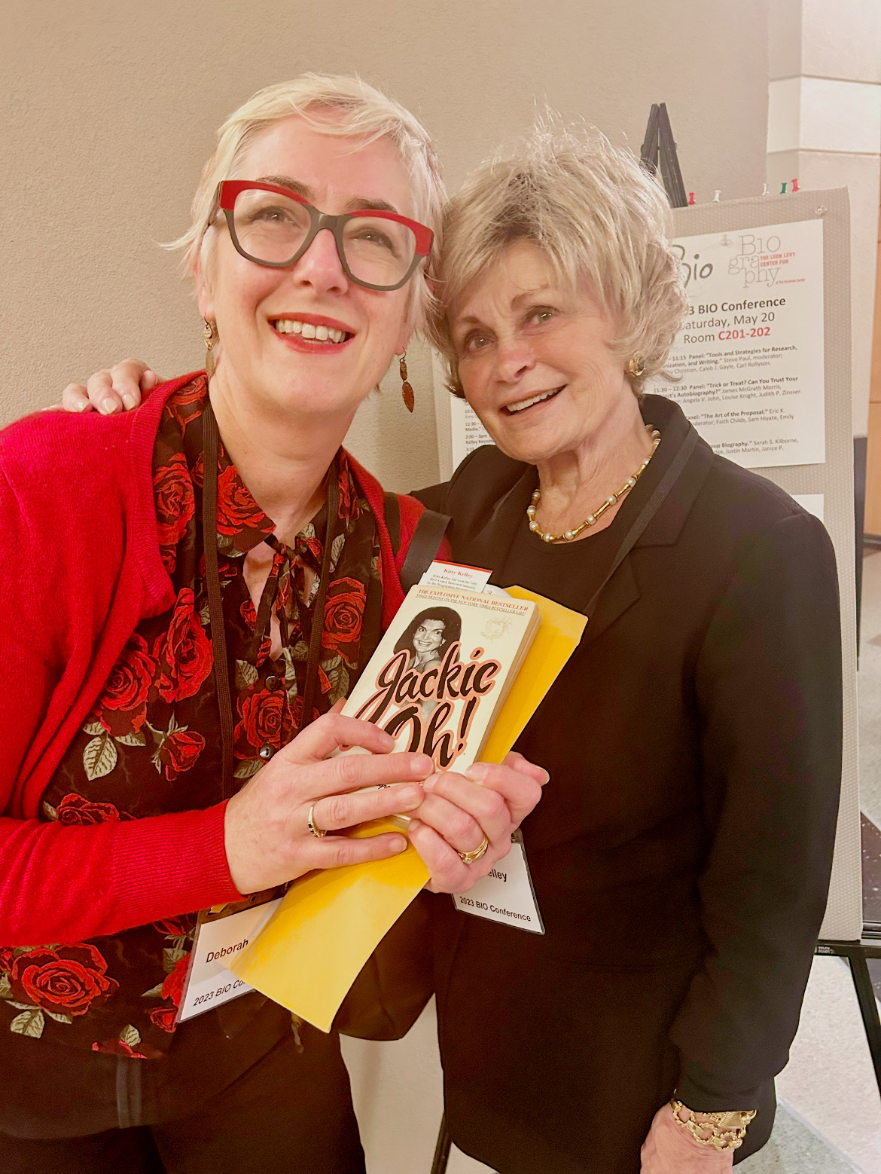
Take outs
Most of the biographers in the BIO group are retirement age.
The US market is huge. Australia could not publish some of the books that get published in the US. We don’t have the market size.
Most do not write about a living person.
Most biographers in the group are academics or retired doctors or lawyers on an independent income.
Meeting Kitty Kelley. She is tiny!

