Slide 1
TITLE
Presenter Name

Slide 2
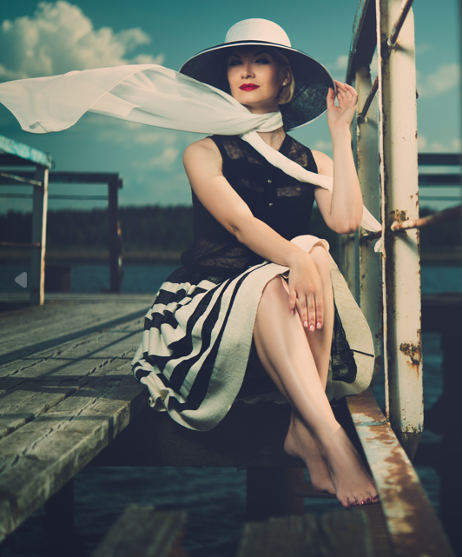
What is Life Stories Australia?
Life Stories Australia (LSA) is an incorporated Association of dedicated and experienced professionals who help individuals, families, communities, organisations and businesses to record and document personal and collective histories or Life Stories.
LSA is dedicated to supporting the craft of life story writing and recording and supporting the professionals who do that.

Slide 3
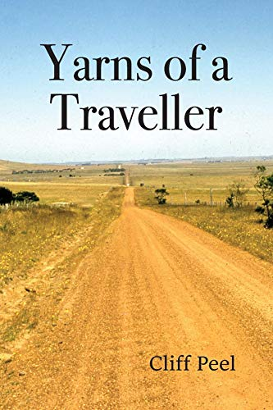
What mediums are the Life Stories represented in?
Members preserve their clients’ stories across a broad range of mediums including print, photographic, image, audio, film, digital and mixed media
As professional storytellers, Life Stories Australia members bring an objective and experienced voice to their client’s story and provide a level of professionalism that goes beyond what a client could potentially have achieved alone.

Slide 4
History of Life Stories Australia
Life Stories Australia was founded in 2017 in response to the need to have Australian personal historians/ biographers gain representation, recognition and promotion in Australia.
As an association, LSA not only promotes the craft of documenting life stories but also seeks to further the professional interests of its member practitioners.

Slide 5
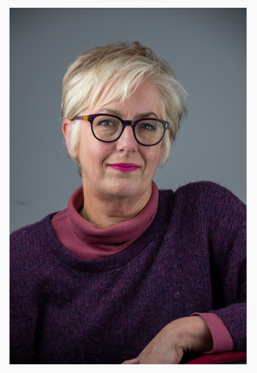
How is LSA governed?
Life Stories Australia is governed by a Board of Directors, all of whom are fully paid members and practising in the industry.
Deborah Gough, President and Principal Spokesperson

Slide 6
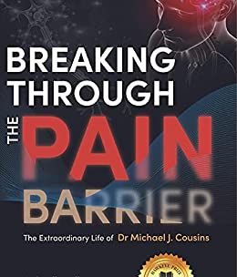
What does LSA offer?
LSA provides and maintains a range of professional services and standards including:
ongoing education and training based on industry best practice and research;
support, networking and collaborative opportunities amongst members;
providing members with links to external relevant educational and professional organisations;
a code of ethics and professional standards for members to follow.

Slide 7
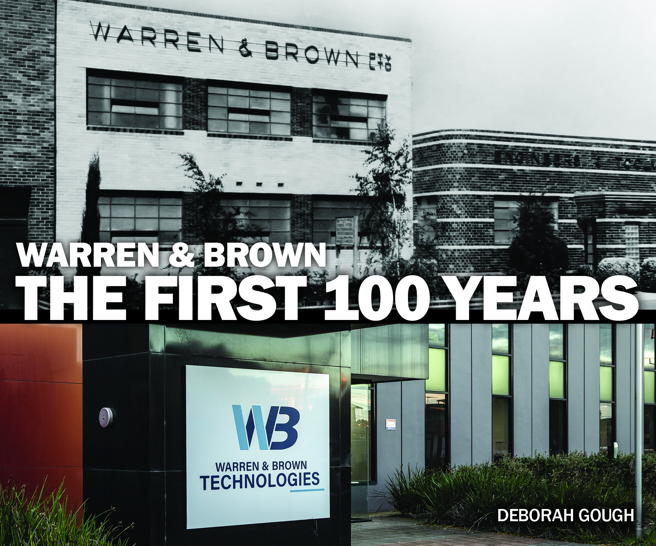
Life Stories Australia Members
LSA members follow a strict code of conduct and are screened for their experience, skill and professional service. This ensures that no matter which member a client chooses and no matter which medium they use, they will receive a professional service.
LSA Members operate in every Australian state:
New South Wales
Victoria
Queensland
South Australia
Tasmania
Western Australia

Slide 8
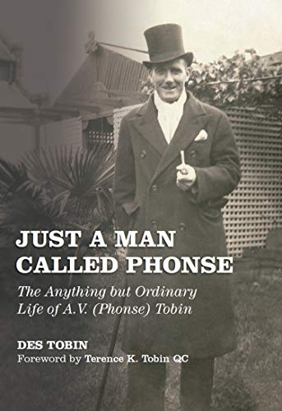
Are you interested in joining LSA?
If you write, record, produce or contribute professionally to life stories, and would like to join our association we would be happy to discuss membership with you.

Slide 9
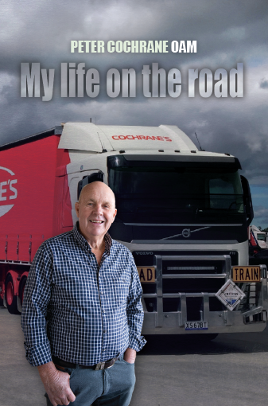
What are the Membership Categories?
Australian Member - Currently working as a Life Story Professional in Australia inclusive areas include biographers, memoirists, personal historians, oral historians, audiographers and videographers, on a part-time or full-time commercial basis.
Allied Member - Working in the life story space as an editor, illustrator, educator, literary agent, publisher, printer, bookseller or other related occupation.
Associate Member - Emerging life story professional who is just starting out, having a career pause, or doing voluntary, honorary or hobby life story work.

Slide 10
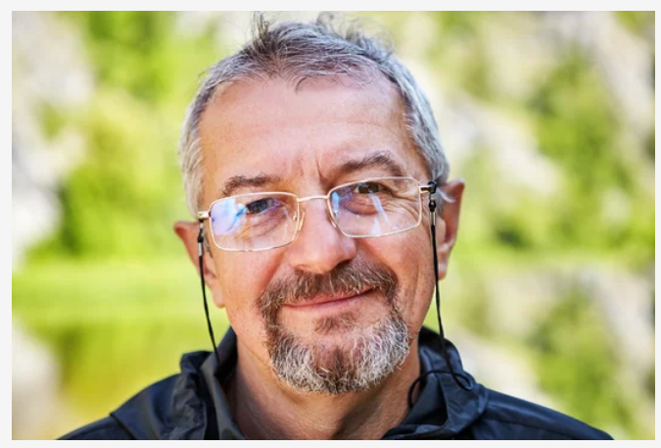
Questions?
If you’re interested in apply for membership, please go to the Life Stories Australia website to find out more:
https://lifestoriesaustralia.com.au/

